Slide 1
Abusing HTML5 permissions on browsers
Joel Niklaus
04/DEC/2018
SCG Software Composition Seminar
Notes:
Clickjacking is a malicious technique of tricking a Web user into clicking on something different from what the user perceives they are clicking on, thus potentially revealing confidential information or taking control of their computer while clicking on seemingly innocuous web pages

Slide 2
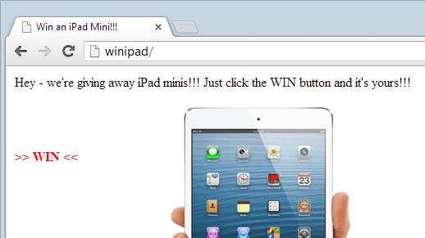

Slide 3
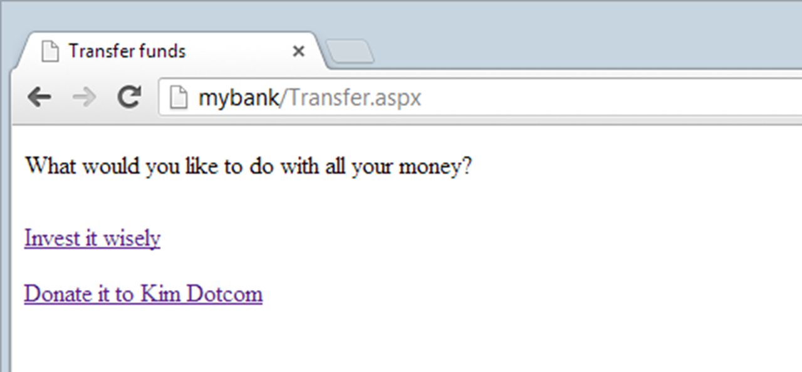

Slide 4

https://www.troyhunt.com/clickjack-attack-hidden-threat-right-in/

Slide 5
Relevance
HTML5 browsers available on all major platforms
HTML5 supports numerous sensitive data providers (geolocation, camera, microphone, etc.)
# potential victims: billions

Slide 6
Motivation
Exploration of technical possibilities
In-depth victim assessment

Slide 7
Threats & Attacks

Slide 8
Threats
Risks
Revelation of confidential information
Hostile computer takeover
Unintended participations of any kind
Gains
Blackmailing as business model
Increasing Twitter reach
Influencing Facebook community
Generating Google AdSense revenue
Gaining popularity on YouTube
Spoofing:
Display
Pointer
Temporal
Notes:
Make user follow someone on Twitter
Make user like something on Facebook
Make user click on Google AdSense ad to generate pay-per-click revenue
Make user play YouTube video to gain views

Slide 9
A) Display Spoofing

Slide 10
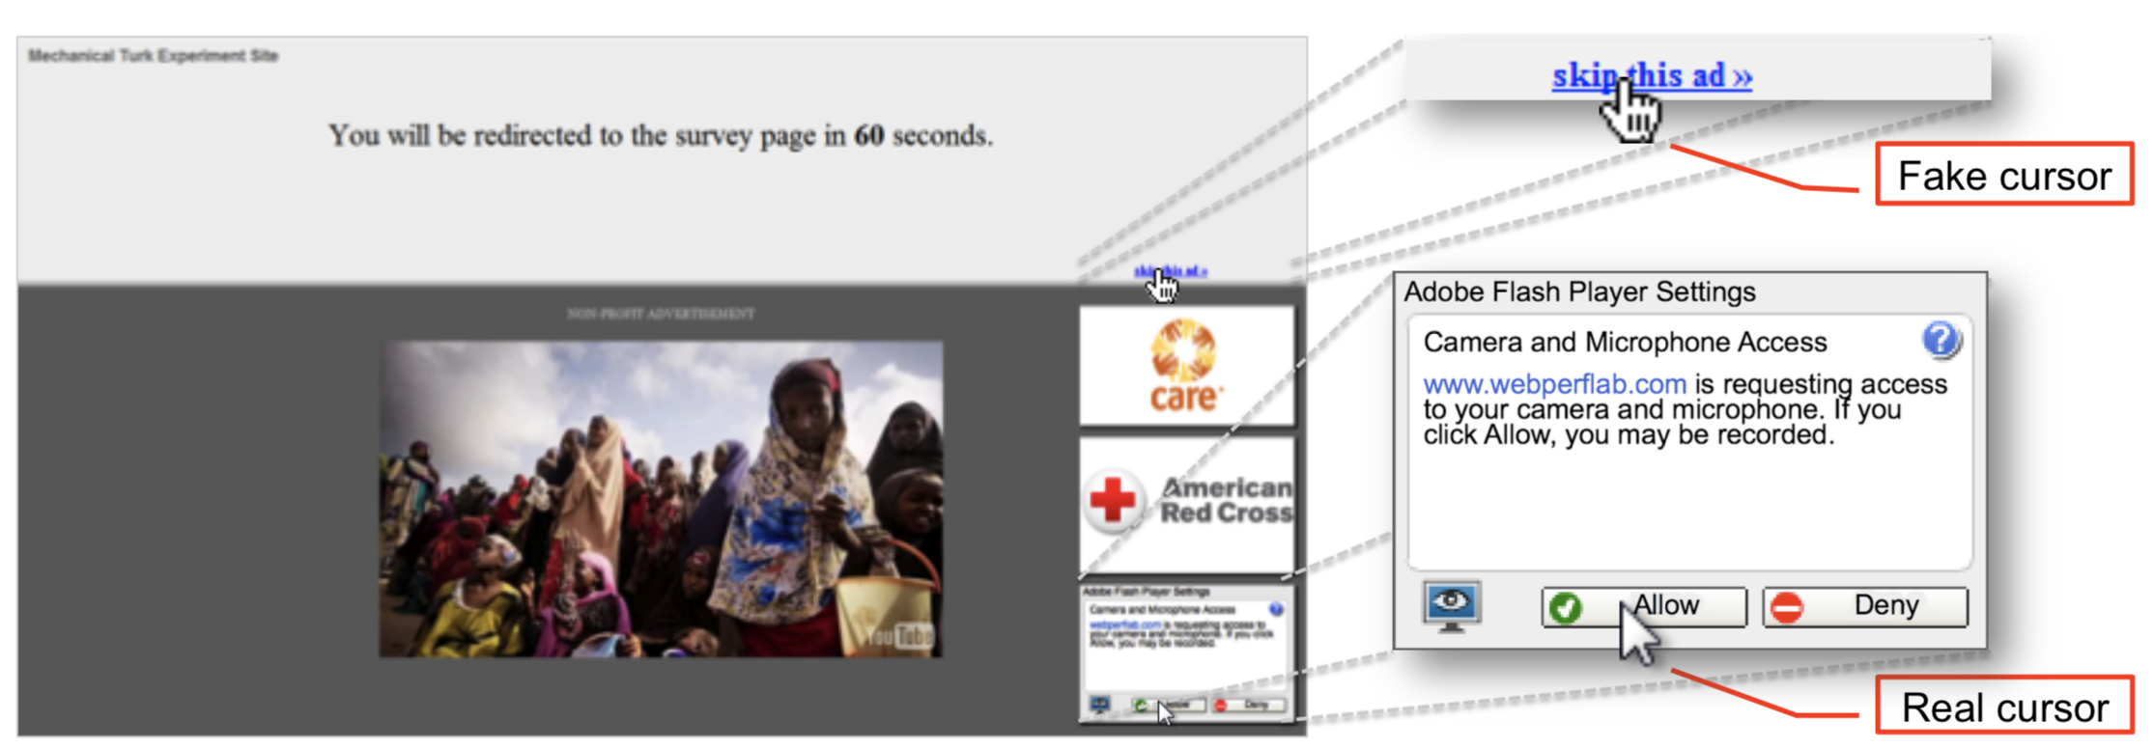
B) Pointer Spoofing
Notes:
Cursor spoofing

Slide 11
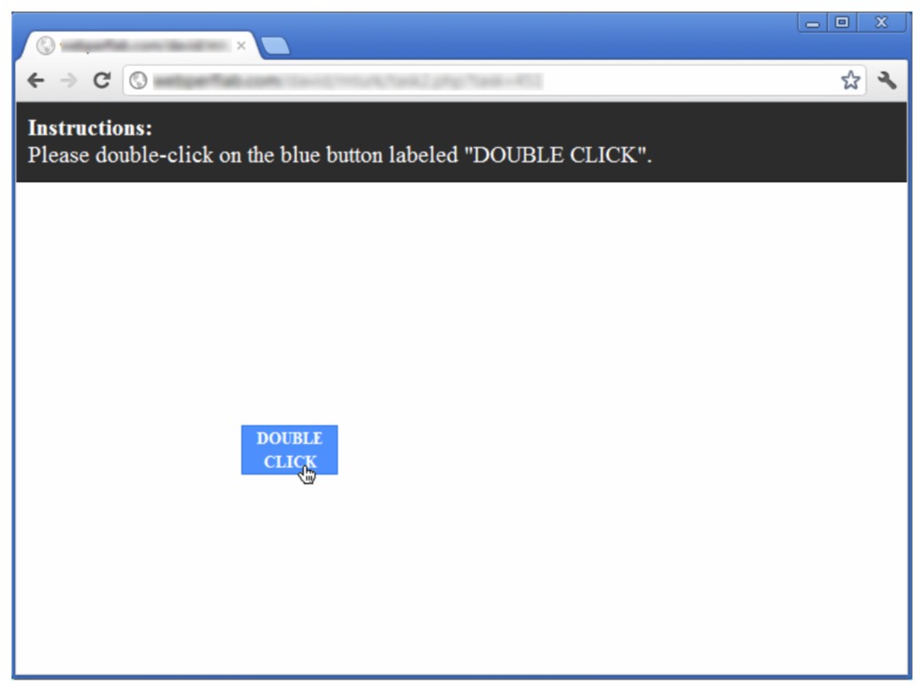
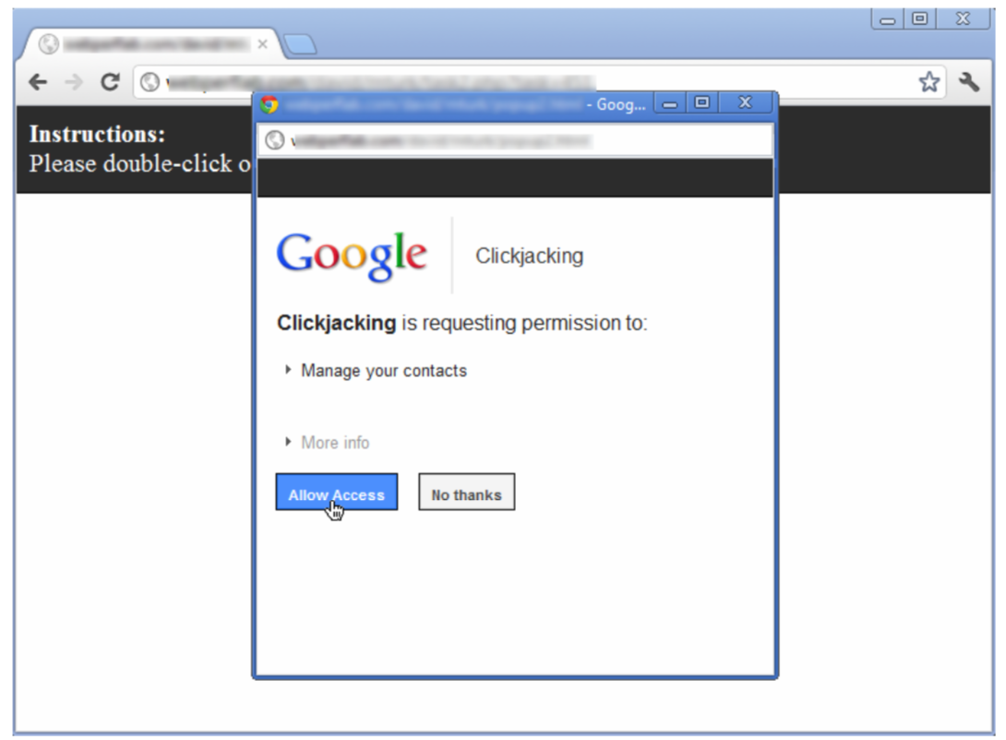
C) Temporal Spoofing
Notes:
Double click attack

Slide 12



Prevalence of Vulnerabilities
Google Explorer API
Facebook iframe
LinkedIn AutoFill plug-in
Notes:
Google Bounty of $1337
Facebook Bounty paid 4 days after discovery
Linkedin Discovered by 18-year old

Slide 13
Defense Mechanisms
Frame busting
HTTP header X-Frame options
DENY any embedding disallowed
SAMEORIGIN only on the same website allowed
ALLOW FROM allowed on the specified websites
JavaScript (defense script / no-script add-on)
GuardedID
Notes:
Frame busting: prevents site from functioning inside frame
HTTP headers: Only works if supported by browser!
Meta tags → not working!
Until supported: use custom JavaScript defense script
No-Script Addon: prevents users from clicking on invisible or "redressed" page elements
GuardedID: forces all frames to become visible
→ Can only target invisible or redressed elements

Slide 14
Technical Details

Slide 15







HTML5 Permission API
// Check for Geolocation API permissions navigator.permissions.query({name:'geolocation'}) .then(function(permissionStatus) { console.log('geolocation permission state is ', permissionStatus.state);
permissionStatus.onchange = function() { console.log('geolocation permission state has changed to ', this.state); }; });
Notes:
Previously: check permission differently for every API
Permission API → Single standardized way

Slide 16
Concept
Intention: Trick users on browser permission dialog
Procedure: 1) Accurate positioning of a fake button 2) Make the user click very fast 3) Speed dependent permission dialog box trigger 4) Distraction of the user 5) Fake end screen
Notes:
Question: There are three types of clickjacking attacks. Which type are we proposing here?

Slide 17
Experiments

Slide 18
Demo #01

Slide 19
Controlled Experiment
People with diverse backgrounds
Controlled environment (same computer and browser)
The majority of people could be fooled!

Slide 20
Uncontrolled Experiment
Computer Science Students
Different computers and browsers
Even people with a strong CS background could be fooled!

Slide 21


Slide 22
Infected System
Permissions are stored in an unprotected SQLite database in the case of Firefox and Chrome on Windows
Suppose a virus infected the computer:
Add the necessary permissions to the SQLite database
Open a hidden (Windows), minimized (Linux) browser window
Navigate the malicious website
Extract the sensitive information (geolocation, audio, video, etc.)
→ Missing permission protection (against data alteration)

Slide 23
Demo #02

Slide 24
Defenses & Future works

Slide 25
Limitations
Proof-of-concept status
Limited compatibility (macOS and Android)
Bookmarks bar and window resize can break attack
Increase the excitement of the game
Investigate permissions on other systems (iOS, Android, etc.)

Slide 26
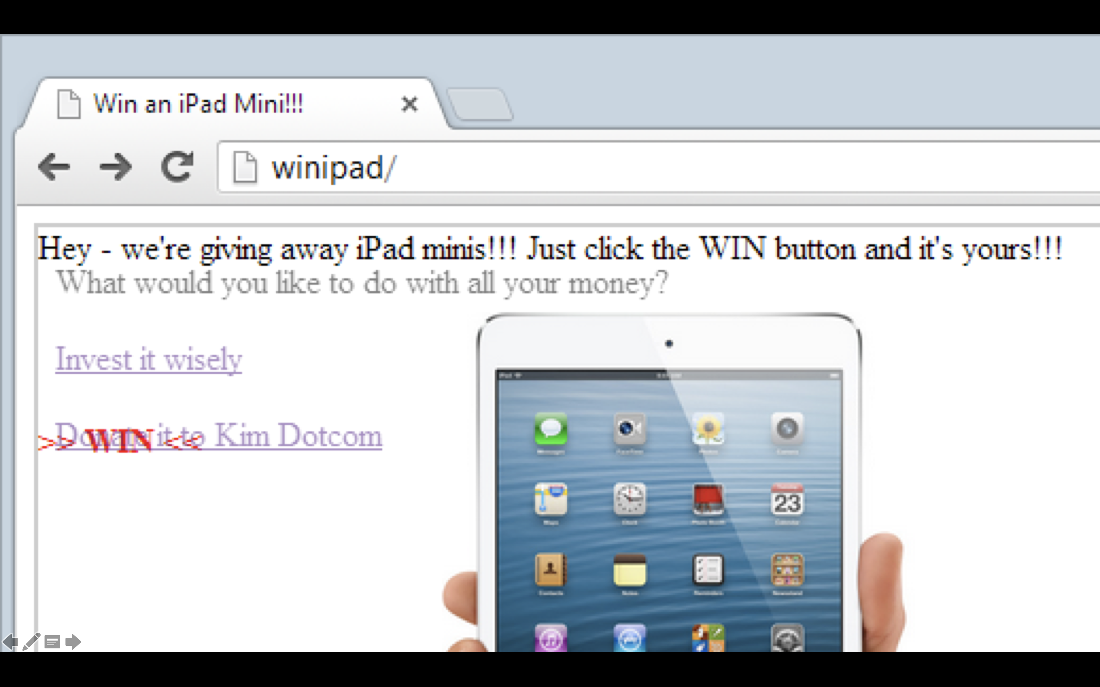
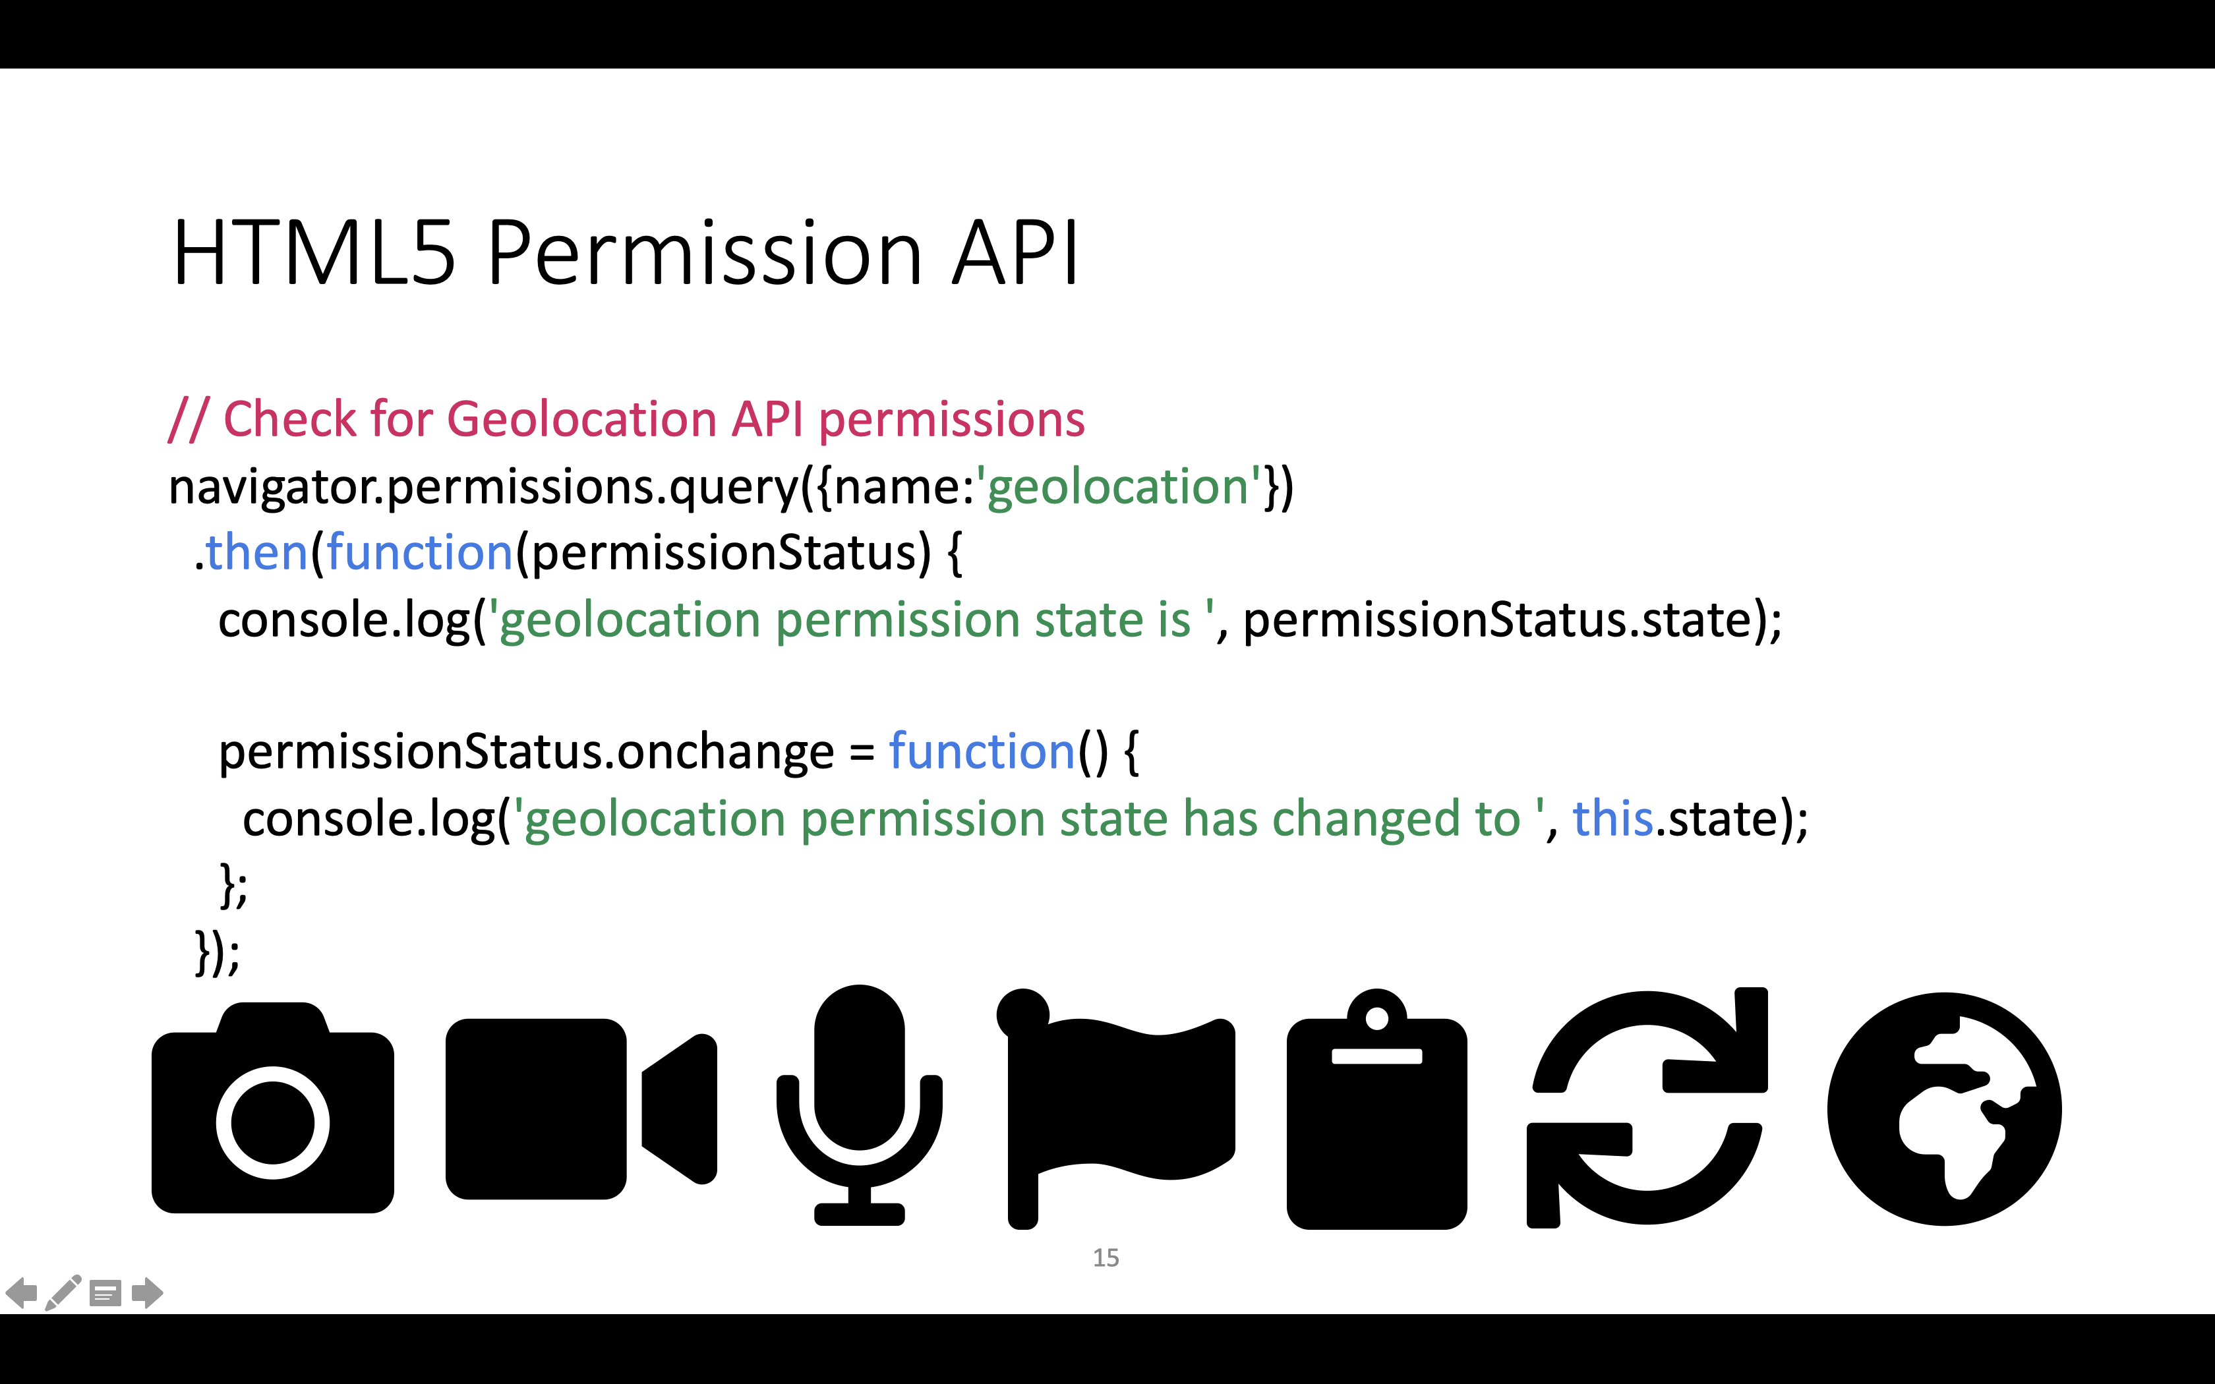
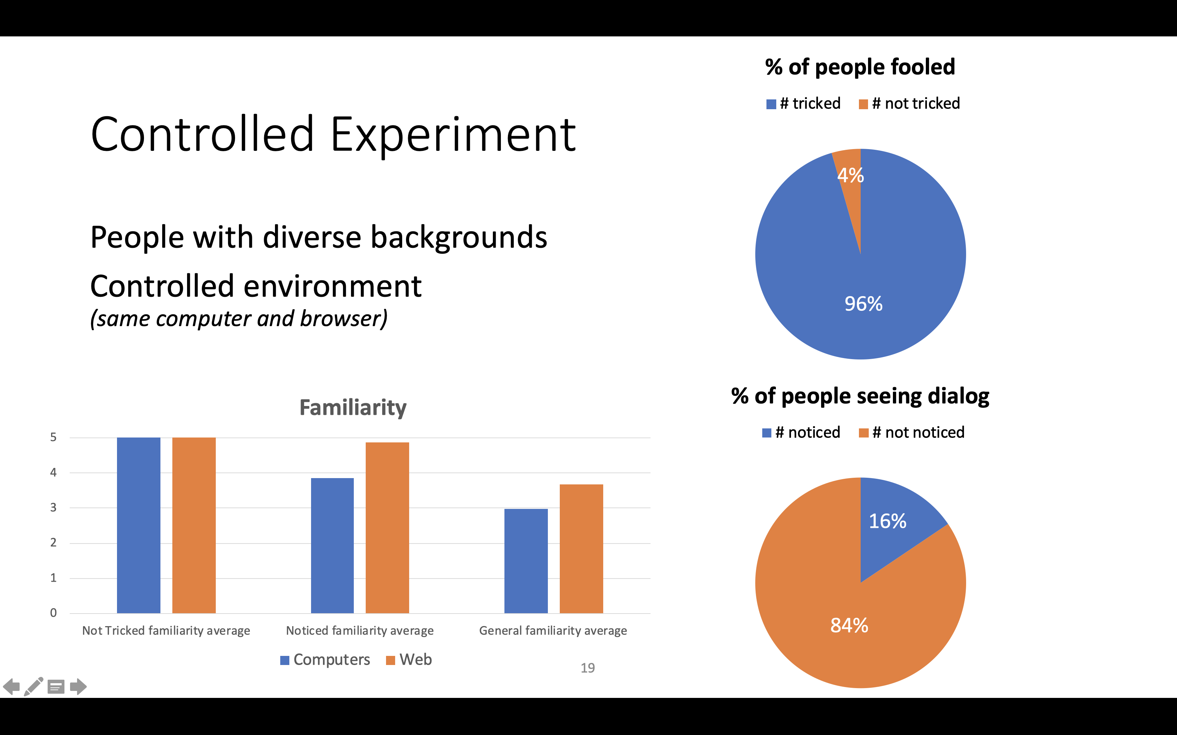
Summary
Threats & Attacks
Technical Details
Experiments
Notes:
Are there any questions?

